Slide 1
Chapter 21
CUDA Dynamic Parallelism

Slide 2
Outline
Introduction to CUDA Dynamic Parallelism
A simple example
A more complex example: Bezier lines
A recursive example: Quadtree
Other cases:
Library calls
Saving kernel launches in ARM CPUs
What is and what is not dynamic parallelism
Summary

Slide 3
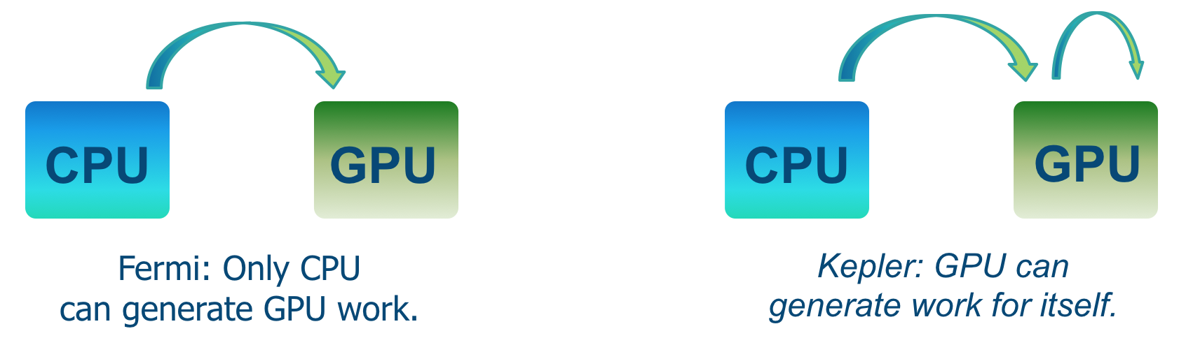
CUDA Dynamic Parallelism
Device-side kernel launches
Kepler GK110 architecture
Typical use cases
Dynamic load balancing
Data-dependent execution
Recursion
Library (with kernels) calls from kernels
Programmability and maintainability

Slide 4
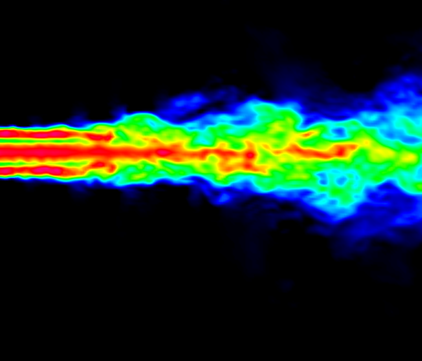
CUDA Dynamic Parallelism
Fixed grid vs. dynamic grid for a turbulence simulation model
Fixed Grid
Statically assign conservative worst-case grid
Dynamic Grid
Dynamically assign performance where accuracy is required
Initial Grid

Slide 5
CUDA Dynamic Parallelism
CPU-GPU without and with dynamic parallelism
CPU
GPU
CPU
GPU
(a) Without Dynamic Parallelism
(b) With Dynamic Parallelism

Slide 6
CUDA Dynamic Parallelism
Nested dependencies
int main() {
float *data;
setup(data);
A <<< ... >>> (data);
B <<< ... >>> (data);
C <<< ... >>> (data);
cudaDeviceSynchronize();
return 0;
}
CPU
GPU
A
X
__global__ void B(float *data)
{
do_stuff(data);
X <<< ... >>> (data);
Y <<< ... >>> (data);
Z <<< ... >>> (data);
cudaDeviceSynchronize();
do_more_stuff(data);
}
B
Y
C
Z

Slide 7
CUDA Dynamic Parallelism
Syntax
kernel_name<<< Dg, Db, Ns, S >>>([kernel arguments]);
Dg is of type dim3 and specifies the dimensions and size of the grid
Db is of type dim3 and specifies the dimensions and size of each thread block
Ns is of type size_t and specifies the number of bytes of shared memory that is dynamically allocated per thread block for this call.
S is of type cudaStream_t and specifies the stream associated with this call.

Slide 8
CUDA Dynamic Parallelism
LU decomposition
Notes:
LU decomposition is used to solve systems of linear equations.

Slide 9
Parent-child synchronization
Synchronization
Parent to child: memory consistency
Child to parent: after cudaDeviceSynchronize()
Notes:
cudaDeviceSynchronize() -> wait until all child kernels launched by any thread in the parent block completed.
If it is not used, the runtime will perform the synchronization implicitly before the parent terminates.

Slide 10
Outline
Introduction to CUDA Dynamic Parallelism
A simple example
A more complex example: Bezier lines
A recursive example: Quadtree
Other cases:
Library calls
Saving kernel launches in ARM CPUs
What is and what is not dynamic parallelism
Summary

Slide 11
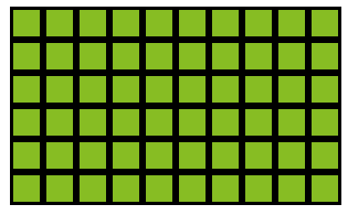
A simple example
Without dynamic parallelism, uniform workload
01 __global__ void kernel(unsigned int start, unsigned int end,
02 float* someData, float* moreData) {
03
04 unsigned int i = blockIdx.x*blockDim.x + threadIdx.x;
05 doSomeWork(someData[i]);
06
07 for(unsigned int j = start; j < end; ++j) {
08 doMoreWork(moreData[j], i);
09 }
10
11 }
Iterations
Threads

Slide 12
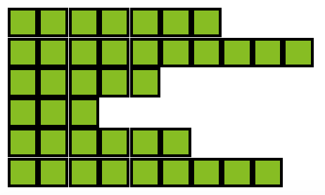
A simple example
Without dynamic parallelism, non-uniform workload
01 __global__ void kernel(unsigned int* start, unsigned int* end,
02 float* someData, float* moreData) {
03
04 unsigned int i = blockIdx.x*blockDim.x + threadIdx.x;
05 doSomeWork(someData[i]);
06
07 for(unsigned int j = start[i]; j < end[i]; ++j) {
08 doMoreWork(moreData[j]);
09 }
10
11 }
Iterations
Threads

Slide 13
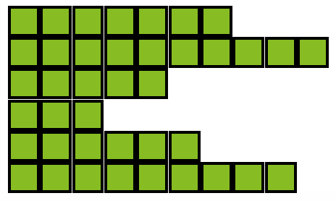
A simple example
With dynamic parallelism, non-uniform workload
01 __global__ void kernel_parent(unsigned int* start, unsigned int* end,
02 float* someData, float* moreData) {
03
04 unsigned int i = blockIdx.x*blockDim.x + threadIdx.x;
05 doSomeWork(someData[i]);
06
07 kernel_child <<< ceil((end[i]-start[i])/256.0) , 256 >>>
08 (start[i], end[i], moreData);
09
10 }
11
12 __global__ void kernel_child(unsigned int start, unsigned int end,
13 float* moreData) {
14
15 unsigned int j = start + blockIdx.x*blockDim.x + threadIdx.x;
16
17 if(j < end) {
18 doMoreWork(moreData[j]);
19 }
20
21 }
Child threads
Kernel calls

Slide 14
Outline
Introduction to CUDA Dynamic Parallelism
A simple example
A more complex example: Bezier lines
A recursive example: Quadtree
Other cases:
Library calls
Saving kernel launches in ARM CPUs
What is and what is not dynamic parallelism
Summary

Slide 15
A more complex example: Bezier lines
Linear Bezier curves
Quadratic Bezier curves
Notes:
Used in vector graphics to generate smooth curves.
Linear: 2 puntos de control. Fórmula de interpolación lineal.
Quadratic: 3 puntos de control. Interpolación lineal de P0 a P1, y de P1 a P2.

Slide 16
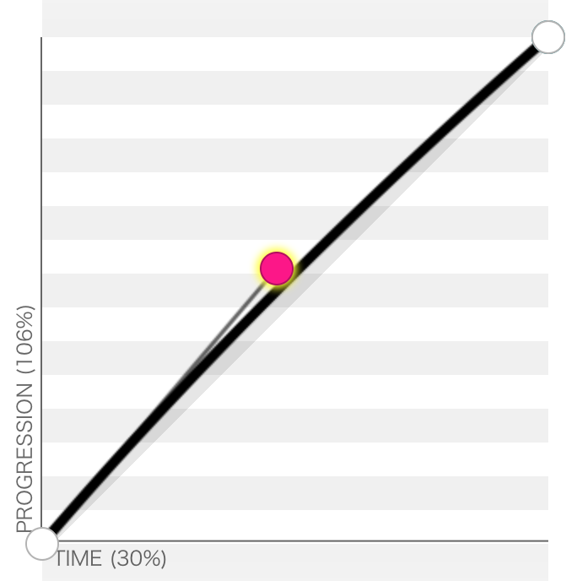
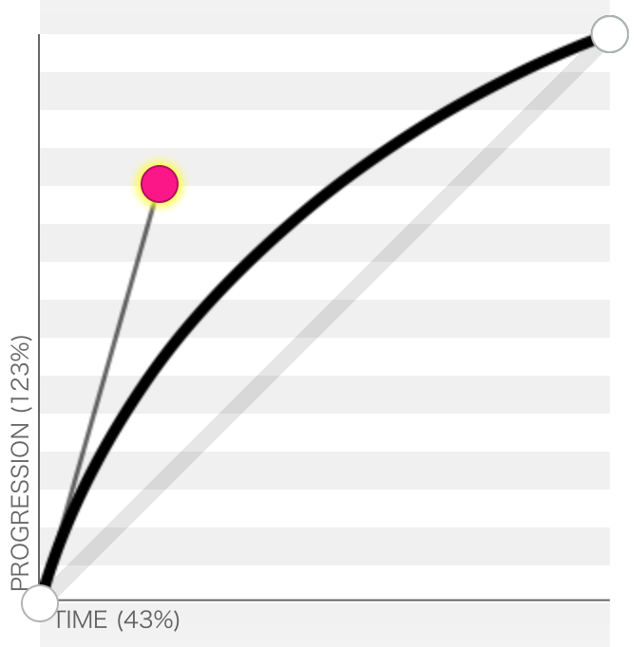
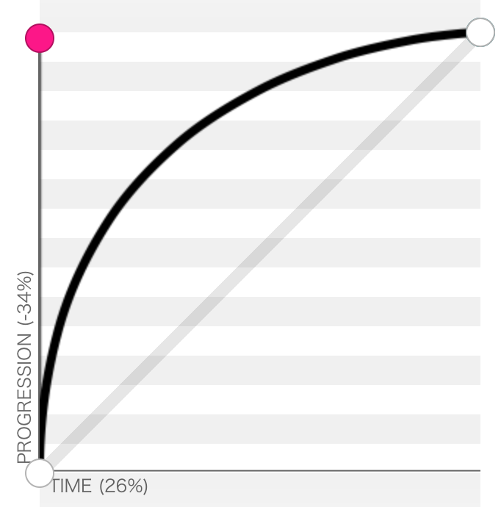
A more complex example: Bezier lines
Control points
Curvature calculation
Tessellation points
P₂
P₁
P₀

Slide 17
A more complex example: Bezier lines
Without dynamic parallelism: One line per block
046 __global__ void computeBezierLines(BezierLine *bLines, int nLines) {
047 int bidx = blockIdx.x;
048 if(bidx < nLines){
049 //Compute the curvature of the line
050 float curvature = computeCurvature(bLines);
051
052 //From the curvature, compute the number of tessellation points
053 int nTessPoints = min(max((int)(curvature*16.0f),4),32);
054 bLines[bidx].nVertices = nTessPoints;
055
056 //Loop through vertices to be tessellated, incrementing by blockDim.x
057 for(int inc = 0; inc < nTessPoints; inc += blockDim.x){
058 int idx = inc + threadIdx.x; //Compute a unique index for this point
059 if(idx < nTessPoints){
060 float u = (float)idx/(float)(nTessPoints-1); //Compute u from idx
061 float omu = 1.0f - u; //pre-compute one minus u
062
063 float B3u[3]; //Compute quadratic Bezier coefficients
064 B3u[0] = omu*omu;
065 B3u[1] = 2.0f*u*omu;
066 B3u[2] = u*u;
067
068 float2 position = {0,0}; //Set position to zero
069 for(int i = 0; i < 3; i++){
070 //Add the contribution of the i'th control point to position
071 position = position + B3u[i] * bLines[bidx].CP[i];
072 }
073 //Assign value of vertex position to the correct array element
074 bLines[bidx].vertexPos[idx] = position;
075 }
076 }
077 }

Slide 18
A more complex example: Bezier lines
With dynamic parallelism
Parent: One line per thread
30 __global__ void computeBezierLines_parent(BezierLine *bLines, int nLines) {
31 //Compute a unique index for each Bezier line
32 int lidx = threadIdx.x + blockDim.x*blockIdx.x;
33 if(lidx < nLines){
34 //Compute the curvature of the line
35 float curvature = computeCurvature(bLines);
36 //From the curvature, compute the number of tessellation points
37 bLines[lidx].nVertices = min(max((int)(curvature*16.0f),4),MAX_TESS_POINTS);
38 cudaMalloc((void**)&bLines[lidx].vertexPos, bLines[lidx].nVertices*sizeof(float2));
39 //Call the child kernel to compute the tessellated points for each line
40 computeBezierLine_child<<<ceil((float)bLines[lidx].nVertices/32.0f), 32>>>
41 (lidx, bLines, bLines[lidx].nVertices);
42 }
43 }

Slide 19
A more complex example: Bezier lines
With dynamic parallelism
Child
07 __global__ void computeBezierLine_child(int lidx, BezierLine* bLines,
08 int nTessPoints) {
09 int idx = threadIdx.x + blockDim.x*blockIdx.x; //Compute idx unique to this vertex
10 if(idx < nTessPoints){
11 float u = (float)idx/(float)(nTessPoints-1); //Compute u from idx
12 float omu = 1.0f - u; //Pre-compute one minus u
13
14 float B3u[3]; //Compute quadratic Bezier coefficients
15 B3u[0] = omu*omu;
16 B3u[1] = 2.0f*u*omu;
17 B3u[2] = u*u;
18
19 float2 position = {0,0}; //Set position to zero
20 for(int i = 0; i < 3; i++) {
21 //Add the contribution of the i'th control point to position
22 position = position + B3u[i] * bLines[lidx].CP[i];
23 }
24
25 //Assign the value of the vertex position to the correct array element
26 bLines[lidx].vertexPos[idx] = position;
27 }
28 }

Slide 20

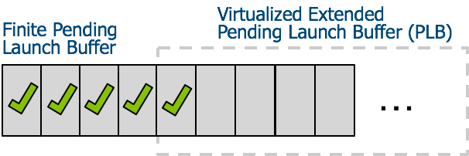
A more complex example: Bezier lines
Launch pool size
Fixed-size pool: default 2048
Variable-size pool
Before CUDA 6.0
Since CUDA 6.0

Slide 21
A more complex example: Bezier lines
Streams

Slide 22
A more complex example: Bezier lines
Streams
//Call the child kernel to compute the tessellated points for each line
// Default stream
computeBezierLine_child<<<ceil((float)bLines[lidx].nVertices/32.0f), 32>>>
(lidx, bLines, bLines[lidx].nVertices);
cudaStream_t stream;
// Create non-blocking stream
cudaStreamCreateWithFlags(&stream, cudaStreamNonBlocking);
//Call the child kernel to compute the tessellated points for each line
computeBezierLine_child<<<ceil((float)bLines[lidx].nVertices/32.0f), 32, 0, stream>>>
(lidx, bLines, bLines[lidx].nVertices);
// Destroy stream
cudaStreamDestroy(stream);

Slide 23
Outline
Introduction to CUDA Dynamic Parallelism
A simple example
A more complex example: Bezier lines
A recursive example: Quadtree
Other cases:
Library calls
Saving kernel launches in ARM CPUs
What is and what is not dynamic parallelism
Summary

Slide 24
A recursive example: Quadtree
Partitioning a 2D space by recursively dividing it into four quadrants
Notes:
21 points

Slide 25
A recursive example: Quadtree
Partitioning a 2D space by recursively dividing it into four quadrants

Slide 26
A recursive example: Quadtree
Partitioning a 2D space by recursively dividing it into four quadrants

Slide 27
A recursive example: Quadtree
Partitioning a 2D space by recursively dividing it into four quadrants
Notes:
Btw, maximum nesting depth is 24 in current architectures

Slide 28
A recursive example: Quadtree
1 thread block is launched from host
Notes:
Points in the same quadrant are grouped together

Slide 29
A recursive example: Quadtree
Each block launches 1 child grid of 4 blocks

Slide 30
A recursive example: Quadtree
Each block launches 1 child grid of 4 blocks

Slide 31
A recursive example: Quadtree
Each block launches 1 child grid of 4 blocks

Slide 32
A recursive example: Quadtree
Points in the same quadrant are grouped together

Slide 33
A recursive example: Quadtree
01 __global__ void build_quadtree_kernel
02 (Quadtree_node *nodes, Points *points, Parameters params) {
03 __shared__ int smem[8]; // Shared memory to store the number of points in each quadrant
04
05 // The current node
06 Quadtree_node &node = nodes[blockIdx.x];
07 node.set_id(node.id() + blockIdx.x);
08 int num_points = node.num_points(); // The number of points in the node
09
10 // Check the number of points and its depth
11 bool exit = check_num_points_and_depth(node, points, num_points, params);
12 if(exit) return;
13
14 // Compute the center of the bounding box of the points
15 const Bounding_box &bbox = node.bounding_box();
16 float2 center;
17 bbox.compute_center(center);
18
19 // Range of points
20 int range_begin = node.points_begin();
21 int range_end = node.points_end();
22 const Points &in_points = points[params.point_selector]; // Input points
23 Points &out_points = points[(params.point_selector+1) % 2]; // Output points
24
25 // Count the number of points in each child
26 count_points_in_children(in_points, smem, range_begin, range_end, center);
27
28 // Scan the quadrants' results to know the reordering offset
29 scan_for_offsets(node.points_begin(), smem);
30
31 // Move points
32 reorder_points(out_points, in_points, smem, range_begin, range_end, center);
33
34 // Launch new blocks
35 if (threadIdx.x == blockDim.x-1) {
36 Quadtree_node *children = &nodes[params.num_nodes_at_this_level]; // The children
37
38 // Prepare children launch
39 prepare_children(children, node, bbox, smem);
40
41 // Launch 4 children.
42 build_quadtree_kernel<<<4, blockDim.x, 8*sizeof(int)>>>
43 (children, points, Parameters(params, true));
44 }
45 }

Slide 34
Outline
Introduction to CUDA Dynamic Parallelism
A simple example
A more complex example: Bezier lines
A recursive example: Quadtree
Other cases:
Library calls
Saving kernel launches in ARM CPUs
What is and what is not dynamic parallelism
Summary

Slide 35
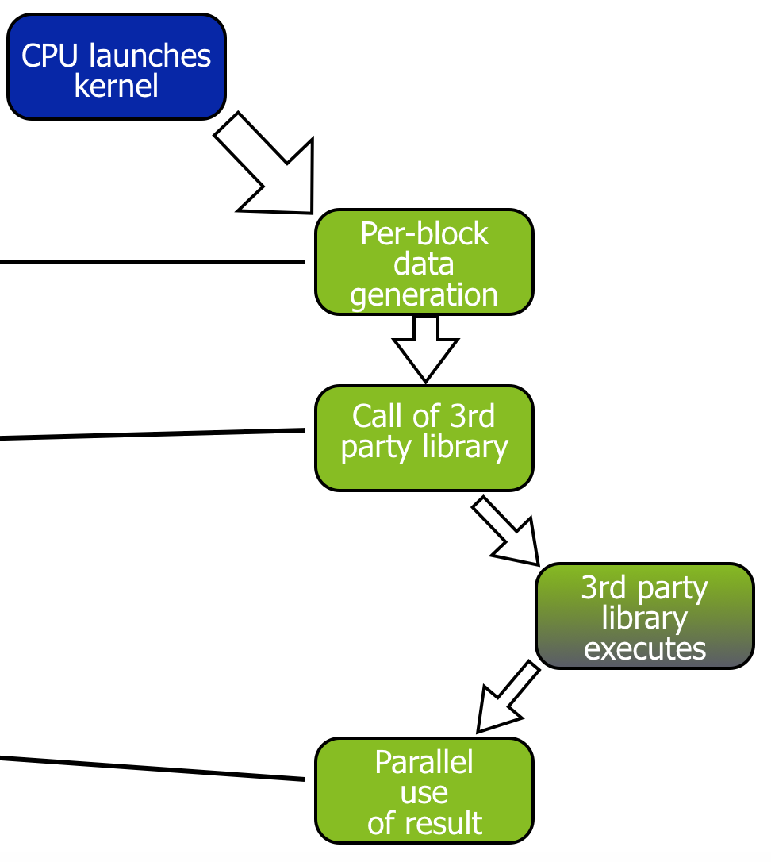
Library calls
Simple library calls
__global__ void libraryCall(float *a,
float *b,
float *c)
{
// All threads generate data
createData(a, b);
__syncthreads();
// The first thread calls library
if (threadIdx.x == 0) {
cublasDgemm(a, b, c);
cudaDeviceSynchronize();
}
// All threads wait for results
__syncthreads();
consumeData(c);
}
Notes:
Don’t get confused with cudaDeviceSynchronize() and __syncthreads()

Slide 36
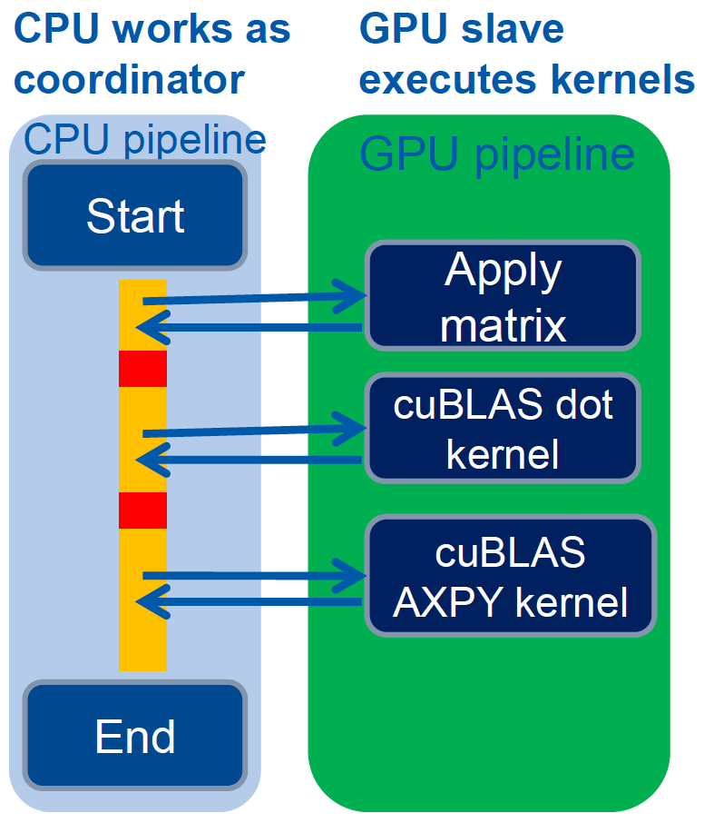
Avoid launch overhead
Lattice QCD
Bottlenecks
Large number of calls to cuBLAS
Dominated by CPU’s capability of launching cuBLAS kernels
ARM CPU is not fast enough to quickly launch kernels: GPU is underutilized
Vishal Mehta, Exploiting CUDA Dynamic Parallelism for low power ARM based prototypes, GTC’2015

Slide 37
Avoid launch overhead
ARM CPUs

Slide 38
Avoid launch overhead
ARM CPUs

Slide 39
Outline
Introduction to CUDA Dynamic Parallelism
A simple example
A more complex example: Bezier lines
A recursive example: Quadtree
Other cases:
Library calls
Saving kernel launches in ARM CPUs
What is and what is not dynamic parallelism
Summary

Slide 40
What is and what is not
CDP ensures better work balance, and offers advantages in terms of programmability.
However, launching grids with a very small number of threads could lead to severe underutilization of the GPU resources.
A general recommendation
Child grids with a large number of thread blocks,
or at least thread blocks with hundreds of threads, if the number of blocks is small.
Nested parallelism (tree processing)
Thick tree nodes (each node deploys many threads)
and/or branch degree is large (each parent node has many children)
As the nesting depth is limited in hardware, only relatively shallow trees can be implemented efficiently.

Slide 41
Summary
CUDA Dynamic Parallelism
Extends the CUDA programming model to allow kernels to launch kernels
Dynamic memory allocation
Dynamically discovered work
Recursive algorithms
Better work balance and more efficient memory usage
What is and what is not CDP

Slide 42
References
Wen-mei W. Hwu, David B. Kirk, and Izzat El Hajj. Programming Massively Parallel Processors: A Hands-on Approach. Morgan Kaufmann, 2022.

